Slide 1

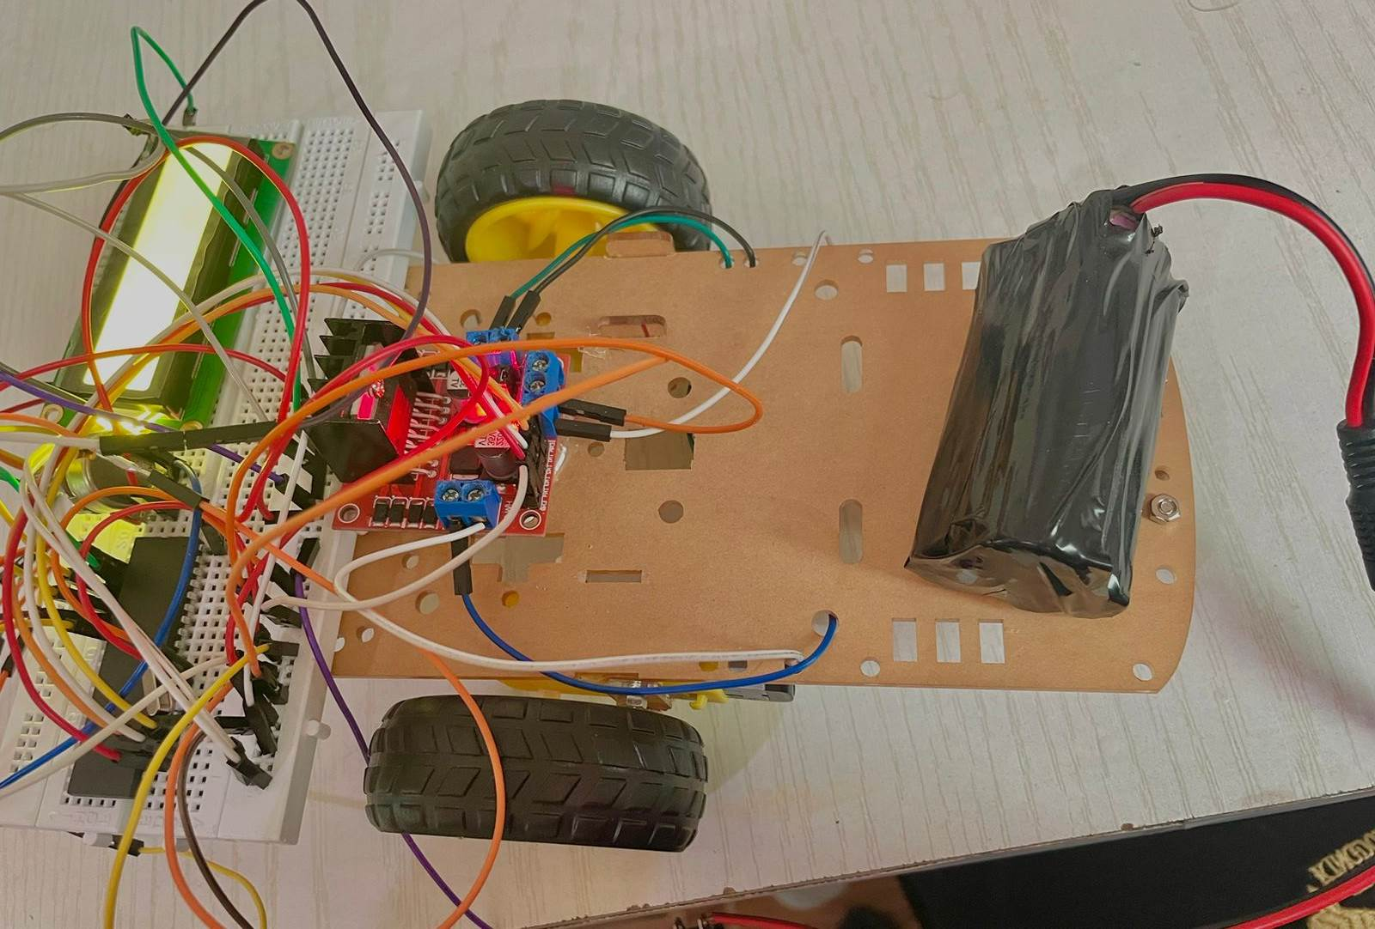
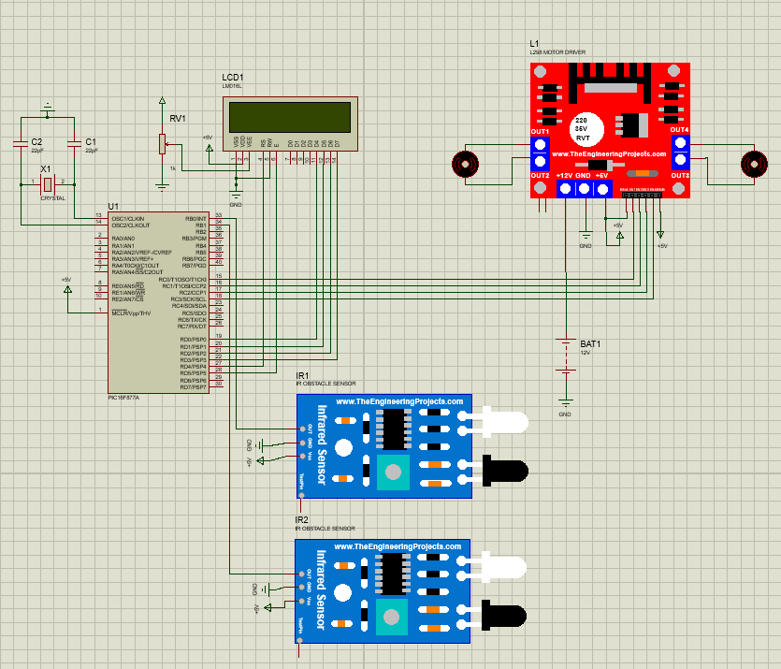
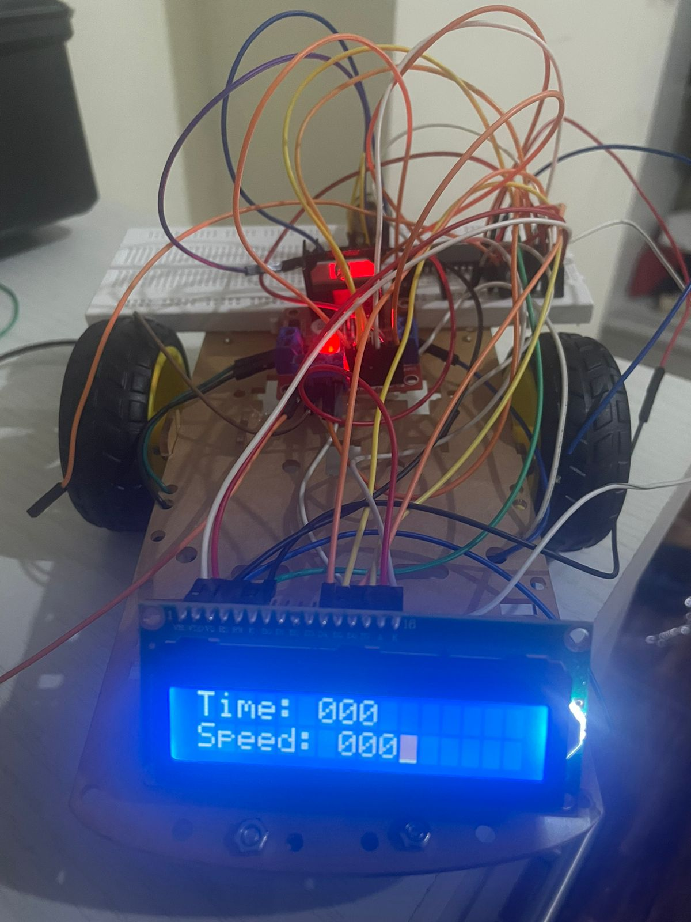
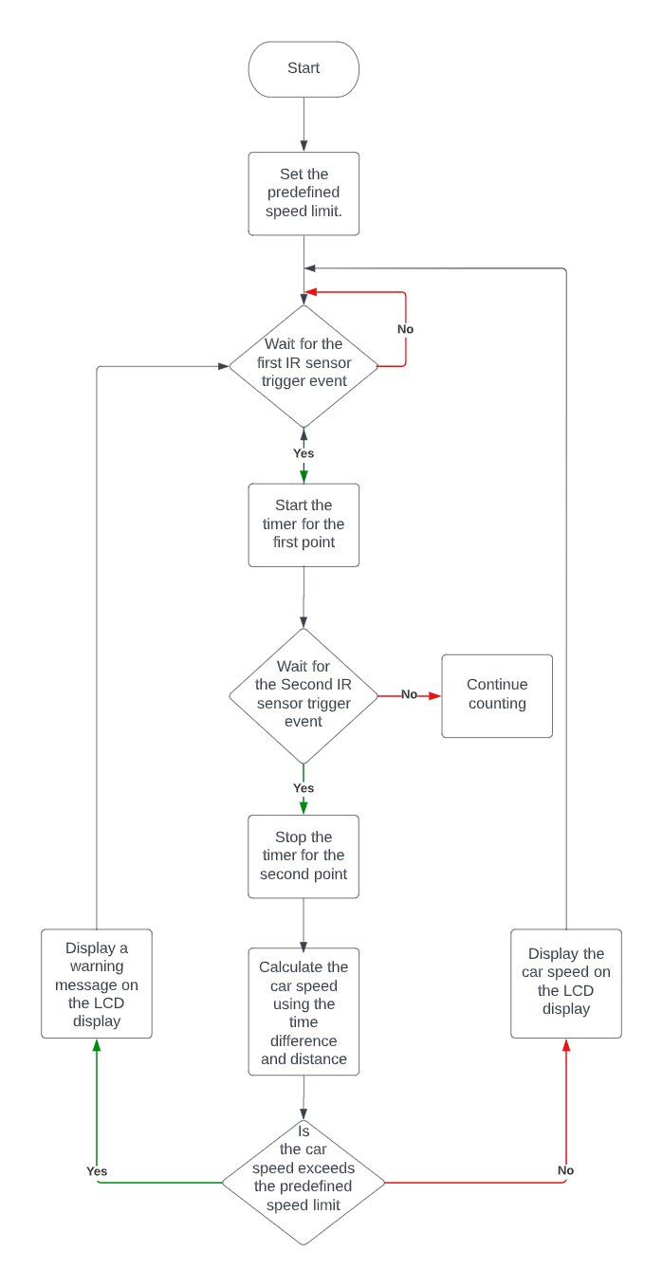
Car Speed Tracker
Z. Abdullah, S. Al Kedra, and F. Tammous
Supervisor: Dr. Belal Sababha
Embedded Systems Final Design Project, Spring 2023
King Abdullah II School of Engineering
Princess Sumaya University for Technology
Introduction
This project focuses on designing and implementing an embedded radar system using a kit car, two DC motors, two infrared (IR) sensors, and an LCD display. The goal is to accurately measure and display the car's speed in real-time. The system employs time-of-flight principles, calculating the speed based on the time difference between the sensors' trigger events. The LCD display provides immediate speed feedback. Accurate speed measurement is essential in various domains, including traffic monitoring, sports analytics, and scientific research. Traditional radar systems are often expensive and complex, limiting their accessibility and practicality. However, this project offers a cost-effective and practical solution that can be easily implemented and adapted to different scenarios. Extensive testing has been conducted to validate the system's accuracy and reliability, making it a reliable choice for speed measurement in various applications.
Results
Figure 4 (a) shows the design our car . Figure 4 (b) is the LCD showing the time and speed.
(a)
(b)
Design
Figure 1: Schematic Diagram
Figure 2: Software Design
Conclusion
In conclusion, this project has successfully developed a radar system capable of accurately measuring and displaying real-time speed. Through the utilization of innovative principles and extensive testing, the system has demonstrated its reliability and precision. The cost-effective nature of this solution addresses the limitations of traditional radar systems, offering a practical and accessible approach to speed measurement. This project signifies the potential for advancements in speed measurement technology and showcases the successful integration of various components.

